Slide 1
Office 365 Development

Slide 2
Advanced Windows 10 development with the Office 365 APIs

Slide 3

Agenda
Introduction
Universal App projects
Integrating Office 365 APIs

Slide 4















Vision
EXTEND OFFICE EVERYWHERE
CONNECT TO OFFICE 365 SERVICES
BUILD USING AN OPEN PLATFORM
Delve
z
Users and groups
Files
Mail
Calendar
My Apps
Video Portal
Contacts
Office Graph
Presentations
Documents
Spreadsheets
Lync
OneNote
Yammer

Slide 5
Universal Windows Platform

Slide 6
A bigger opportunity with one Windows
Xbox 360
Xbox One
Unified core
Unified app platform
One Store
Converged
OS kernel
Windows 8
Windows 8.1
Converged
app model
Windows 10
Windows Phone 8.1
Windows Phone 8
Easy for users to get & stay current
Windows Phone 7.5
Windows on Devices
Notes:
Platform convergence has been a journey which ends today with Windows 10
We started by using the same Internet Explorer code + engine on Windows Phone 7.5 and Xbox 360; and we started implementing the Microsoft modern design language.
With the release of Windows 8, we converged the Windows kernel (which aligns, among other things, the HAL and driver models). Windows Phone 8 took advantage of new lighter-weight kernel to enable multiple CPUs and other improvements, and the Xbox One was built on top of Windows 8. Xbox also introduced xJS, Xbox’s version of WinJS so developers could write apps in HTML/WinJS the same framework as available on Windows 8.
With the release of Windows Phone 8.1 the runtimes from Windows 8.1 and phone came together as well – continuing up the Windows stack and building upon the kernel convergence that happened in 8.0 – aligning the app models and API set, bringing 90%+ API convergence and unification/convergence of things like Windows Notification Services, back-stack behavior, sharing contracts, live tiles, etc.
With Windows 10, we bring complete the unification of Windows families, and now provide a Windows core that can be used on embedded and IoT devices.
Background data:
9/15/11 Windows Phone 7.5
10/26/12 Windows 8
10/29/12 Windows Phone 8
10/18/13 Windows 8.1
11/22/13 Xbox One
4/8/14 Windows 8.1 Update
3/26/14 Windows Phone 8.1

Slide 7
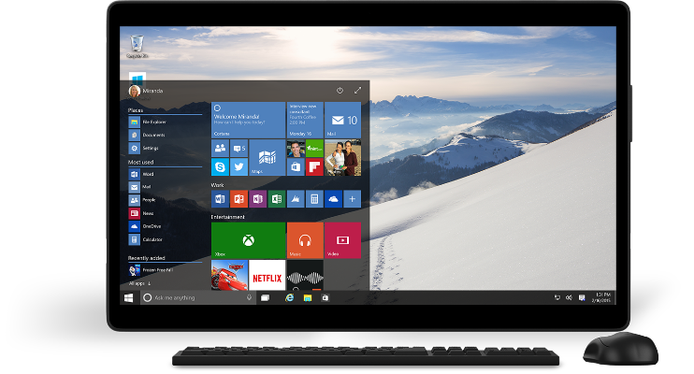
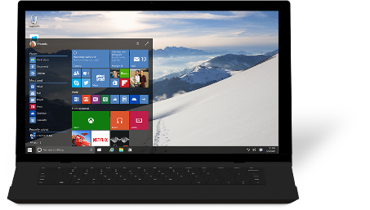
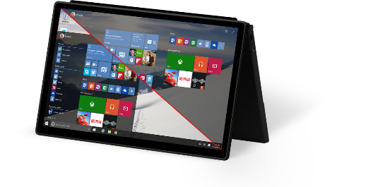
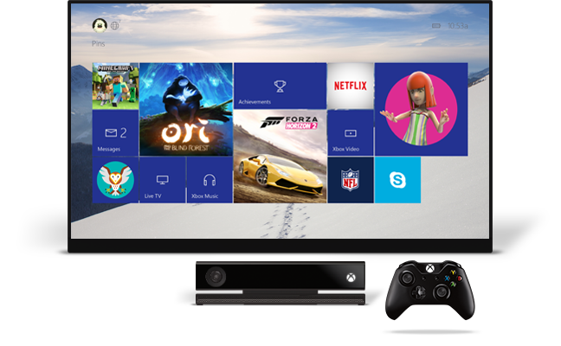
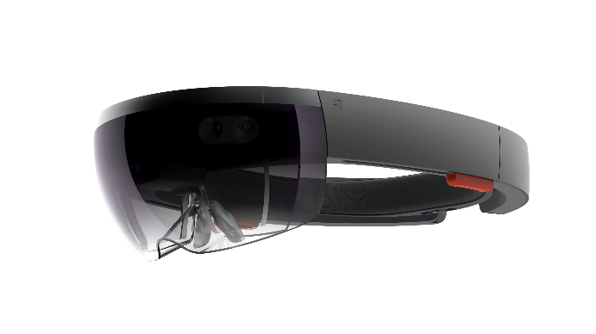
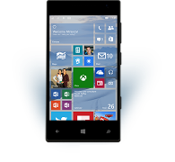
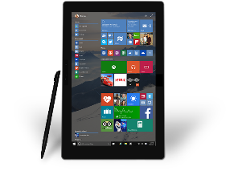
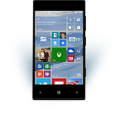
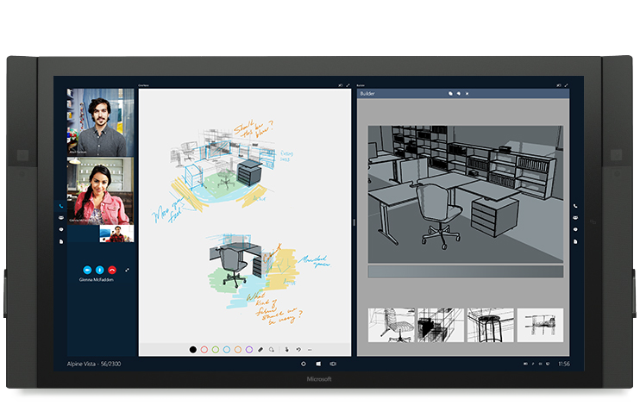










…and one app platform
Universal Windows platform
PC
Holographic
Mobile
Console
Devices +IoT
Surface Hub
Adaptive User Interface
Full Support for Existing Code
Natural User Inputs
One Store + One Dev Center
SDK + Services
Notes:
To bring the family together, Windows 10 is built upon a unified core (the Windows core) and a unified app platform (Universal Windows platform), meaning that all of our device families run Windows at their core. This provides the consistency that users need and the tailored experiences desire.
Gone are the days of Microsoft maintaining a number of code-bases that works to build bridges across silos; Windows has evolved to do that itself. And gone are the days of ISVs doing this as well – targeting Windows provides a single roadmap to the billion+ Windows screens.
Enabling this consistent, yet tailored, Windows experience are a number of services:
Adaptive UX: User interface design that adapts and reacts to the device family it’s running on
Natural user inputs: Speech, natural ink, gesture and facial recognition
Cloud-based intelligent services: Cortana AI, personal hubs, OneDrive, Office 365, Windows notification services, credential locker
Windows Store: Universally available apps and games, digital media
For the app builder, this also means that you can build one Windows solution that runs across all of the Windows device families, and use these Windows services to tailor your experience at runtime.

Slide 8
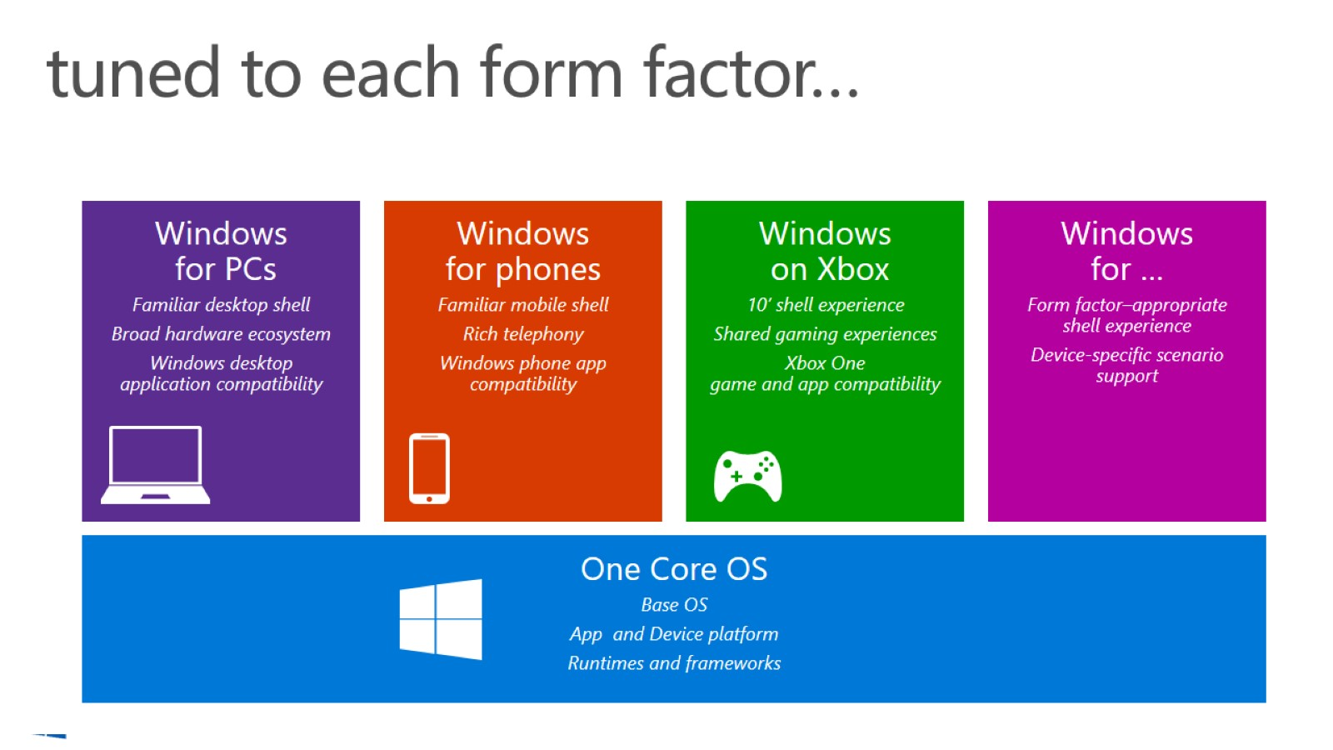
tuned to each form factor…

Slide 9
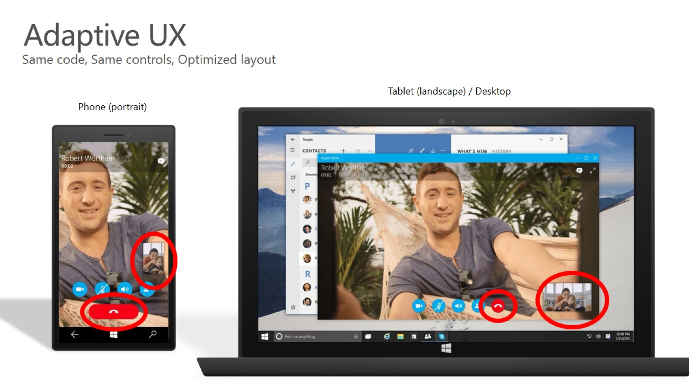
Adaptive UX

Slide 10
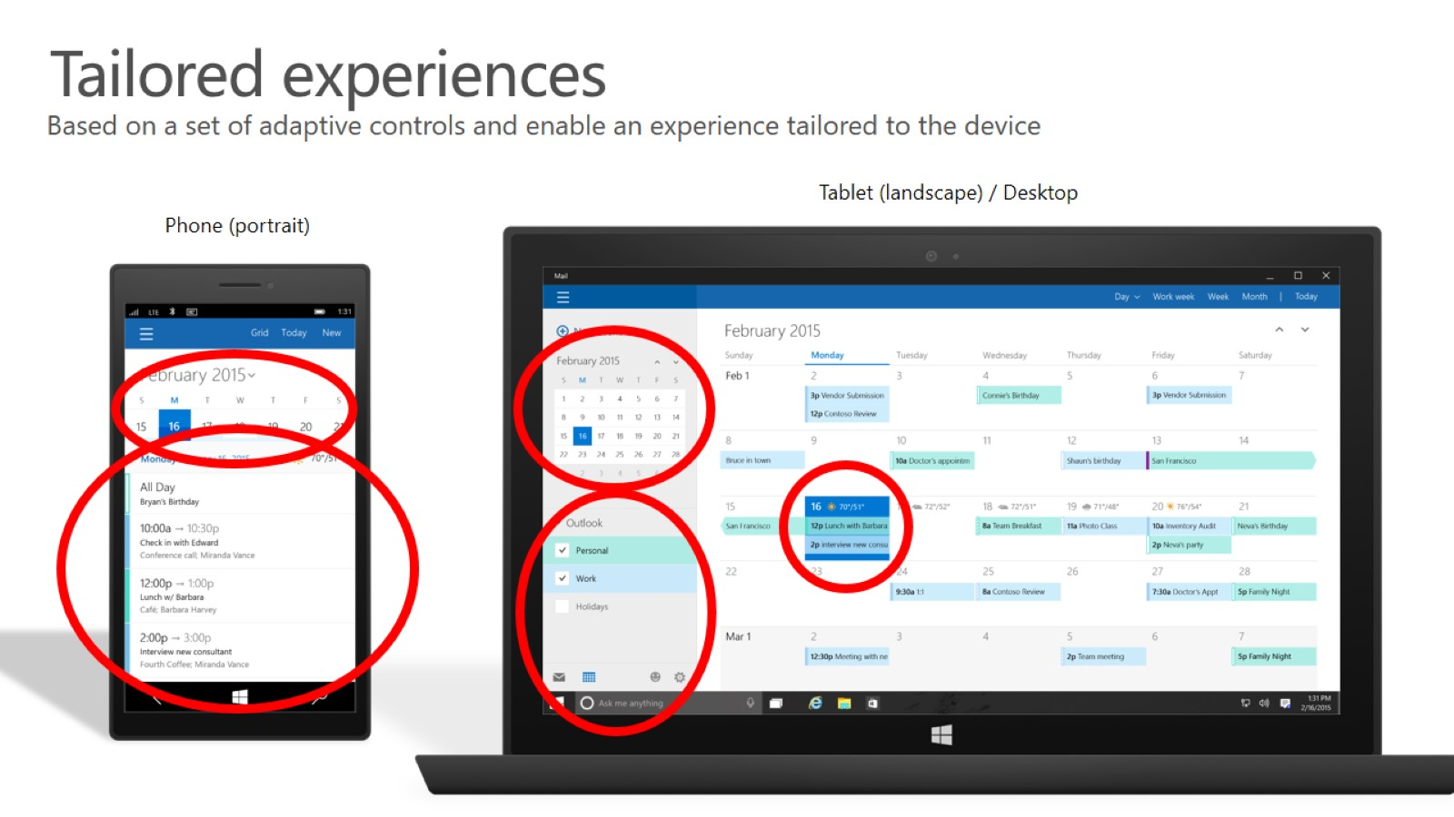
Tailored experiences

Slide 11
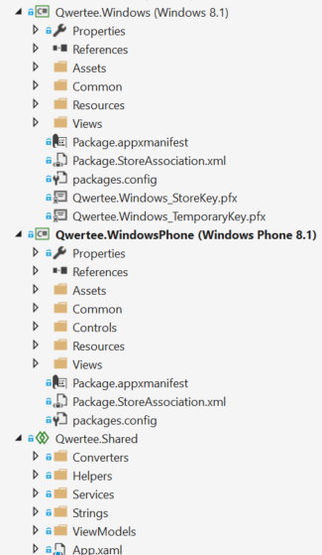
Universal Windows 8.1 apps
#if WINDOWS_APP
ResourceLoader loader = new ResourceLoader();
string about = loader.GetString("SettingsLabel/Text");
string privacy = loader.GetString("PrivacySettings/Text");
string options = loader.GetString("Settings/Text");
ISettingsService settings = container.RegisterSettingsService();
settings.RegisterFlyoutCommand<AboutViewModel>(about);
settings.RegisterFlyoutCommand<PrivacyPolicyViewModel>(privacy);
settings.RegisterFlyoutCommand<SettingsViewModel>(options);
#endif

Slide 12
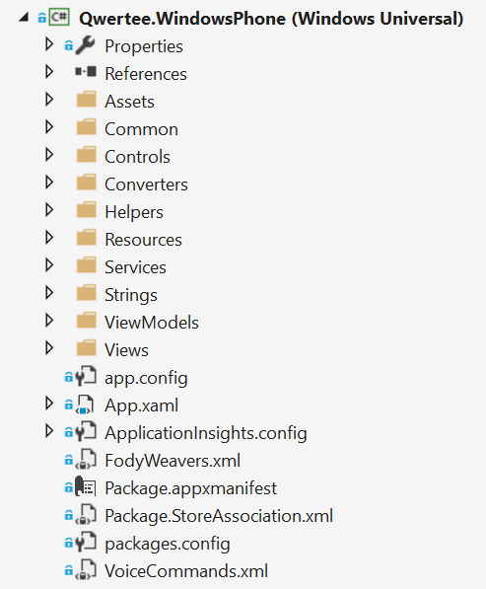
One binary for every device
No more shared project and specific platforms project
No more conditional code
Only one Store
The Universal Windows Platform is available on every Windows 10 device

Slide 13
Universal Windows Platform
It’s a collection of contracts and extensions
When you create an app you target a version of the UWP, not of the operating system
<Dependencies>
<TargetDeviceFamily Name="Windows.Universal" MinVersion="10.0.10069.0" MaxVersionTested="10.0.10166.0" />
</Dependencies>

Slide 14
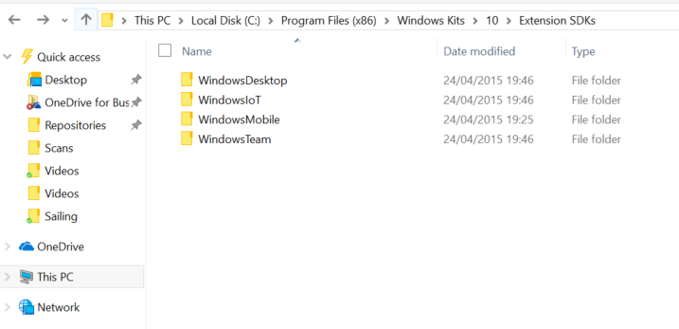
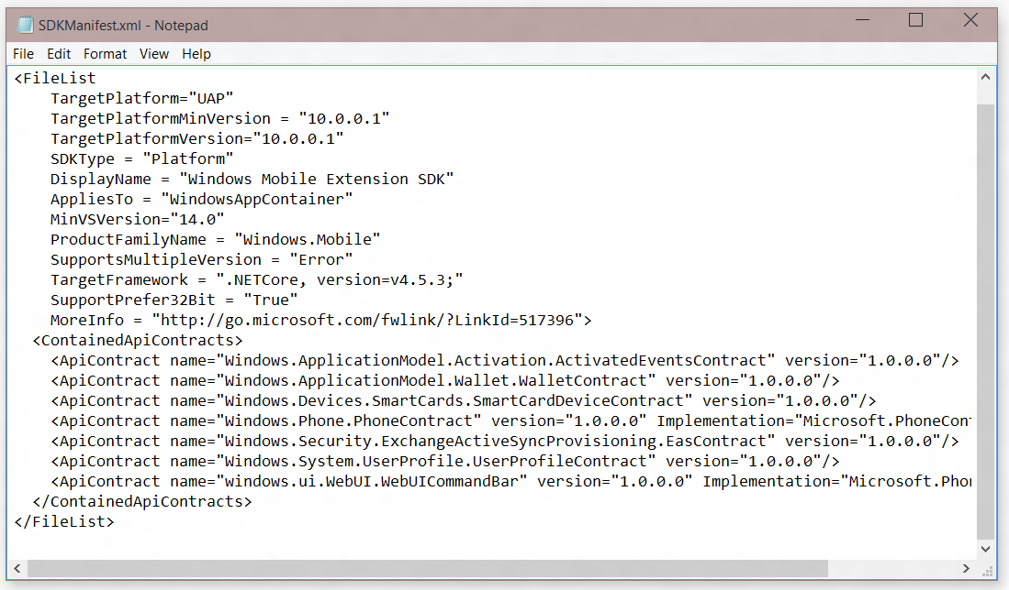
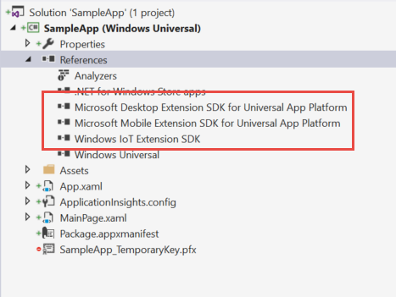
Platform extensions
SDKs to add specific platform APIs on top of the Universal Windows platform

Slide 15
demo
Universal App template
Notes:
Create a new UWP application and build a simple responsive layout (TBD)

Slide 16
Integrating Office 365

Slide 17
Add Office 365 to Universal App
Add Connected Service
Registers application in Azure AD and imports necessary assemblies
Create a data source
XAML makes heavy use of data binding, embrace that paradigm
Stateful client
Initiate login/consent and store Discovery Context

Slide 18
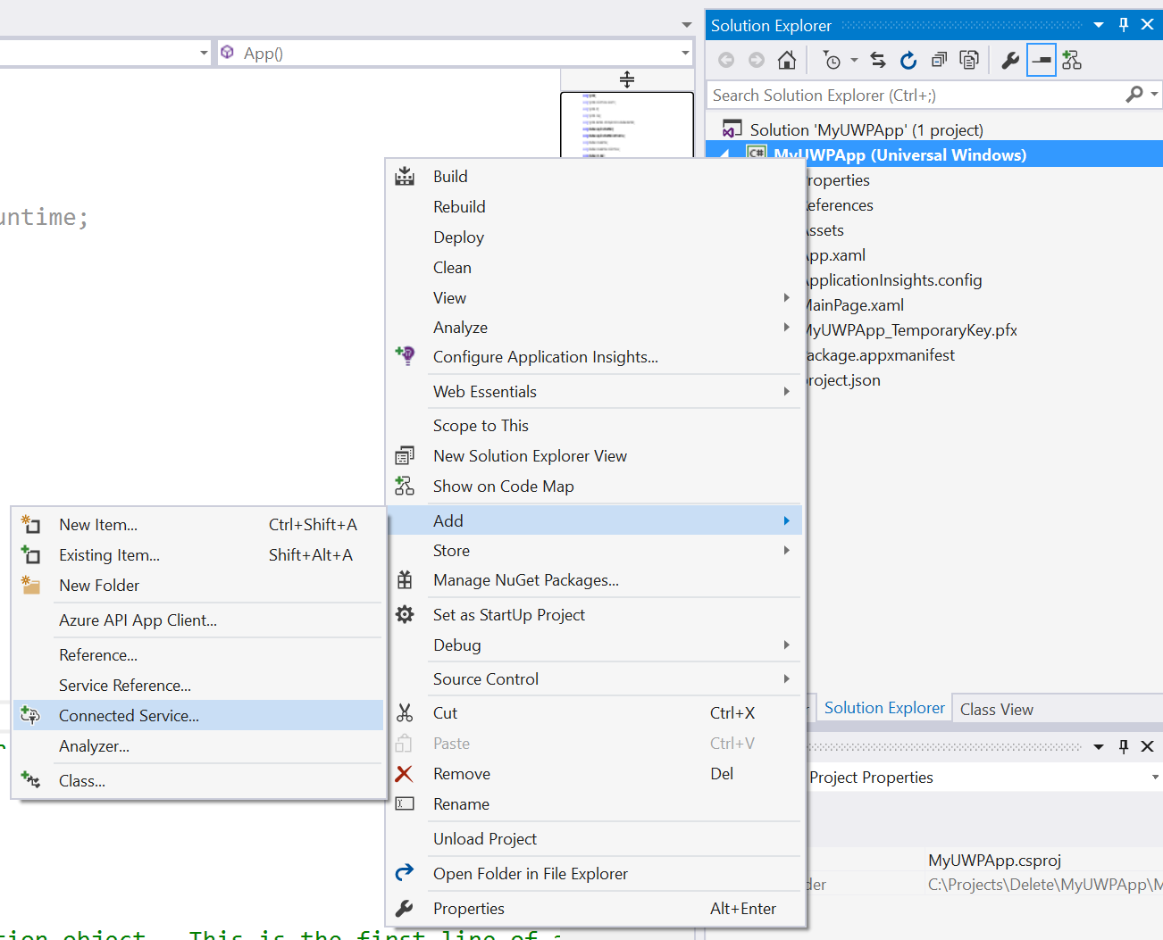
Adding Connected Services
1
Project > Add > Connected Service…

Slide 19
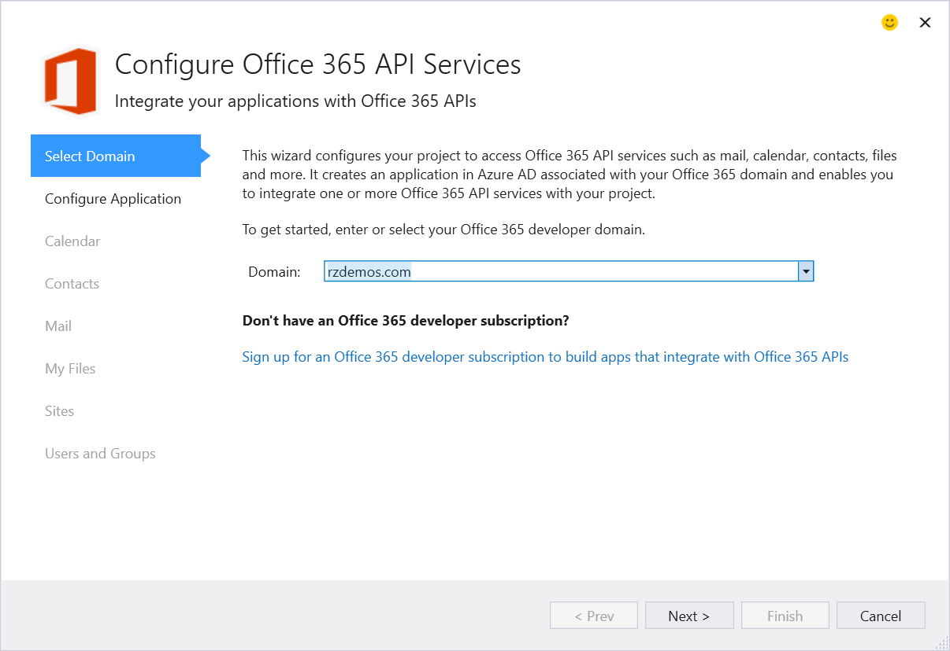
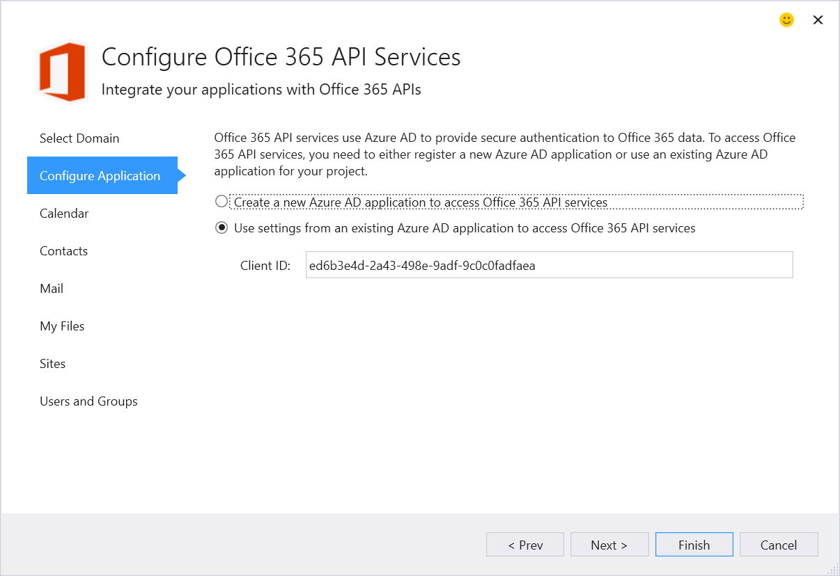
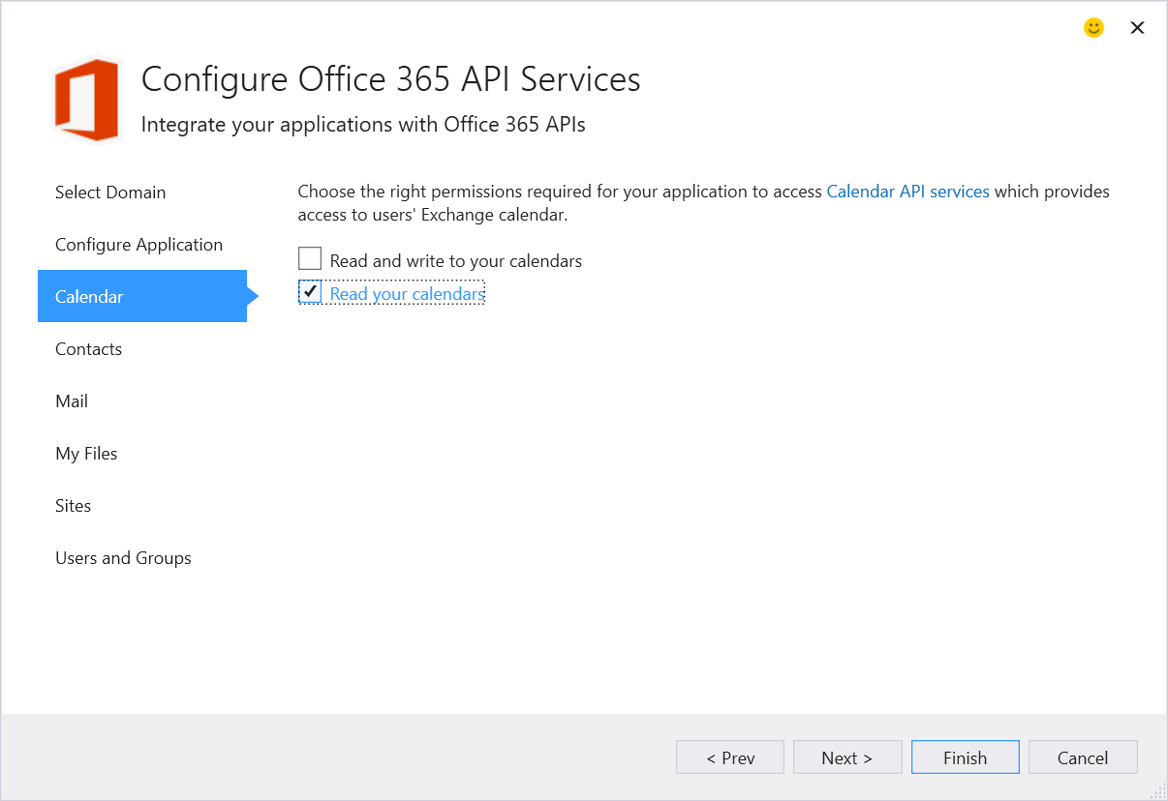
Adding Connected Services
2
Specify Tenant
3
Configure App
2
Select Permissions

Slide 20
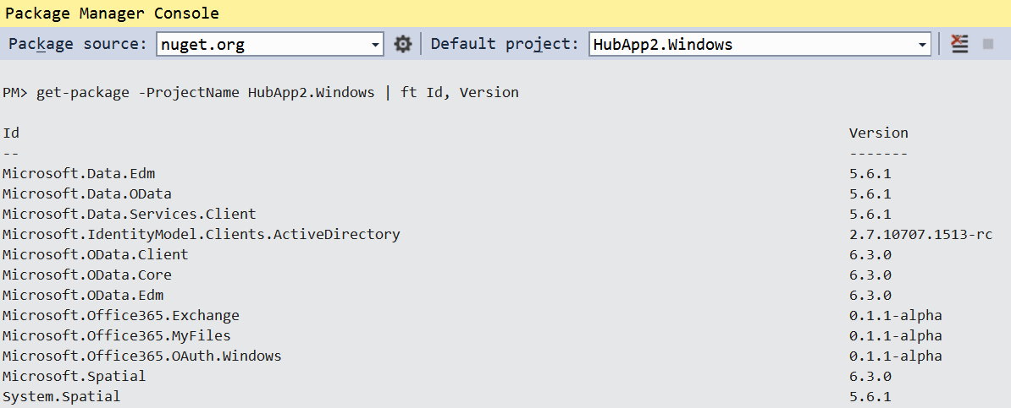
Add Connected Service
Installs NuGet Packages for Office 365 and dependencies

Slide 21
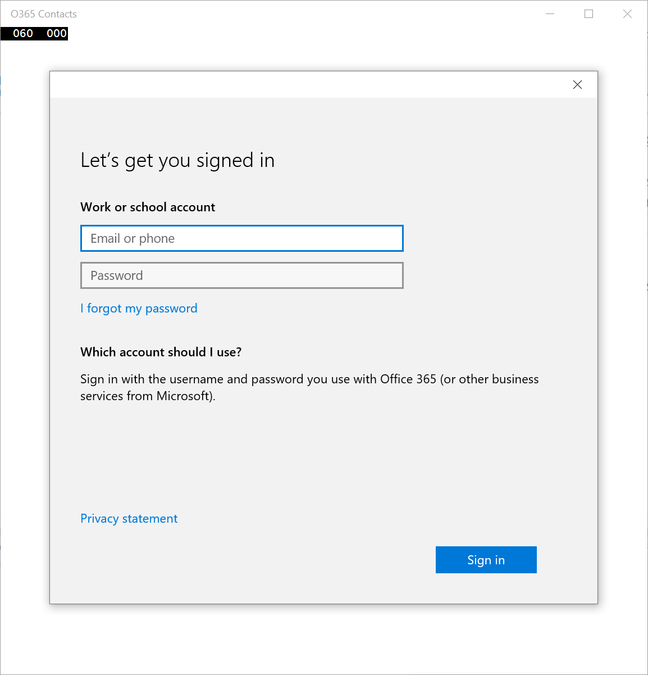
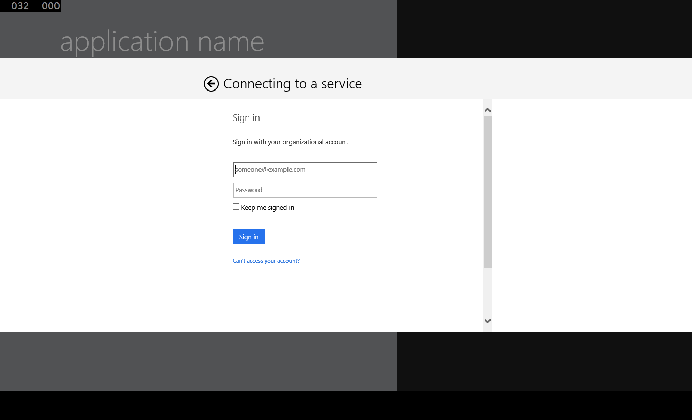
OAuth Implementation
Use Web Account Manager when…
In most scenarios as this is the default for connected service wizard
Your app targets Windows 10 and/or multiple logins (see example)
Use Web Authentication Broker when…
Your app uses AAD and ADFS only
Your app targets Win7 and/or iOS/Android (via Xamarin)
You need to target authentication flows not supported by WAM

Slide 22
Authentication Compared
Web Account Manager
var webTokenRequest = new WebTokenRequest(aadAccountProvider, String.Empty, CLIENT_ID, WebTokenRequestPromptType.ForceAuthentication); webTokenRequest.Properties.Add("authority", AUTHORITY); webTokenRequest.Properties.Add("resource", resourceId); webTokenRequestResult = await WebAuthenticationCoreManager.RequestTokenAsync(webTokenRequest);
Web Authentication Broker
var authenticationContext = new AuthenticationContext(String.Format(AUTHORITY, TENANT)); var accessToken = (await context.AcquireTokenAsync(resourceId, CLIENT_ID, RETURN_URI)).AccessToken;

Slide 23
Office 365 Service Communication
“Client” objects for each service
ExchangeClient
SharePointClient
Constructor takes a “token getter” function
DiscoveryContext wraps an AuthenticationContext
AuthenticationContext has methods for getting tokens

Slide 24
“Client” object constructor example
return new ExchangeClient(ExchangeServiceEndpointUri, async () =>
{
return (await _discoveryContext.AuthenticationContext
.AcquireTokenSilentAsync(
ExchangeServiceResourceId,
_discoveryContext.AppIdentity.ClientId,
new ActiveDirectory.UserIdentifier(
dcr.UserId,
UserIdentifierType.UniqueId)
)
).AccessToken;
});

Slide 25
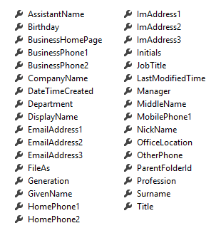
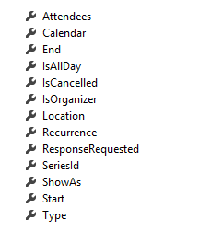
Office 365 Service Communication
Client Object exposes properties
Most are IEnumerable<T> collections
Designed much like Entity Framework
Client == DataContext
IEnumerable<T> entities
Includes common CRUD operations
Contact
Event

Slide 26
demo
Office 365 UWP App
Notes:
OneDrive Images

Slide 27
Summary
Introduction
Universal App projects
Integrating Office 365 APIs

Slide 28



dev.office.com
Sign up
http://dev.office.com/getting-started
Explore
http://apisandbox.msdn.microsoft.com
Get trained http://dev.office.com/training

Slide 29


Feedback
Office 365 Network Share you best practices and join conversations https://www.yammer.com/itpronetwork
Stackoverflow Ask deep technical questions to a world-wide set of developers
http://stackoverflow.com/questions/tagged/ms-office
UserVoice Provide suggestions of what you want in future versions
http://officespdev.uservoice.com/

Slide 30

© 2012 Microsoft Corporation. All rights reserved. Microsoft, Windows, and other product names are or may be registered trademarks and/or trademarks in the U.S. and/or other countries.
The information herein is for informational purposes only and represents the current view of Microsoft Corporation as of the date of this presentation. Because Microsoft must respond to changing market conditions, it should not be interpreted to be a commitment on the part of Microsoft, and Microsoft cannot guarantee the accuracy of any information provided after the date of this presentation. MICROSOFT MAKES NO WARRANTIES, EXPRESS, IMPLIED OR STATUTORY, AS TO THE INFORMATION IN THIS PRESENTATION.

